Slide 1
Important comment for the presenter:
This presentation contains custom shows per industry which shows examples for that industry.
When a slide is specific to an industry, this is indicated in the footer (IPS for Standard Tooling, BPS for Standard Tooling).

Slide 2
IBM’s Industry Models – Standard Tooling
Orchestration Process Model (OPM)

Slide 3
Disclaimer Notice
Licensed Materials - Property of IBM
© Copyright IBM Corp. 2014. All Rights Reserved.
MATERIAL RESTRICTED TO LICENSED CUSTOMERS ONLY - DO NOT DISTRIBUTE
Employee Personal Use and Education: You may download this material for your own personal use and education in support of IBM's business. You may not (a) transfer any material downloaded for these purposes to any external customer or any other employee or (b) use it in support of your own business outside of IBM.

Slide 4
Objectives
Understand the OPM structure
Learn about the different types of model elements used in OPM
Learn about the organization of the OPM
Learn about the relationship between the OPM and other models

Slide 5
Agenda
Positioning of OPM in Standard Tooling model set
Process model structure
  Process hierarchy
  Process diagrams
Summary

Slide 6
Industry SOA Models consist of a set of Process and Service Models
The Industry SOA Models components
Are used as a reference
Are customized
by both business and IT communities to accelerate the analysis and design phases of an SOA solution
Process and Service Models for Standard Tooling
Vocabulary
Business
Terms
Business
Object Model (BOM)
Analysis Process Model (APM)
Design Model
Datatypes (DMD)
Interface Design Model (IDM)
Services Design Model (SDM)
Orchestration Process Model (OPM)
Service Models
Process Models
Requirements
Analysis
Design
Notes:
IIW models are displayed for completeness.

Slide 7
Enterprise-wide data models accelerate the development of SOA solutions
Analysis Process Model (APM):
Provides the business specification of the processes which is used to underpin the initial analysis activities in determining the optimum subset of processes for a Project from a business perspective
Analysis Process Model (APM)
Orchestration Process Model (OPM)
Orchestration Process Model (OPM):
Provides the design level technical specification of the processes which forms the basis for any downstream implementation of executable processes
Process Models

Slide 8
The Orchestration Process Model is a design model that represents the Business Processes
WHAT?
Design level business processes - intended for execution
Contains equivalent business processes to the APM, but in which candidate service
tasks are replaced with ServiceTasks, which invoke Services
The structure of OPM data artefacts are defined by Service Design Model primitive types, enumerations and Transfer Objects
Data must pass consistently through OPM business processes. Data in OPM business processes must also be consistent with data in Service Messages
WHY?
Template process models to design service sub process.
Note: the out of the box OPM business processes are not execution ready. Further work is required before they can be executed
OPM business processes can “orchestrate” complex invocations of Services
Notes:
The main features of the Business Object Model are:
It is enterprise-wide and applies to the industry, independently of any line-of-business considerations.
It can be understood by both business people and IT staff, providing a powerful and precise means of communication and helping to bridge the innate gap between business and IT perspectives.
It is independent of any organizational or technological considerations, providing a stable basis for business modelling.
It provides a flexible view of the business, which can be customized according to specific requirements.
It provides a strong starting-point for analysis and design of operational systems, that potentially use design models, such as an operational data store (ODS), a data warehouse model, a service model or a component design model.
It is mapped to the upstream Business Term concepts it represents.
The downstream design models are mapped to the Business Object Model.
Typically, the Business Object Model is a logical only model, which isn't expected to be physicalized.

Slide 9
Agenda
Positioning of OPM in Standard Tooling model set
Process model structure
  Process hierarchy
  Process diagrams
    BPMN2.0
    BPMN elements in process diagrams
Summary

Slide 10
OPM is
Orchestration Process Model (OPM):
Provides the design level technical specification of the processes which forms the basis for any downstream implementation of executable processes
Process and Service Models for Standard Tooling
Vocabulary
Business
Terms
BOM
APM
DMD
IDM
SDM
OPM
Service Models
Process Models
Models business processes, and service subprocesses arranged in specific areas of business interest
Template process models fast track the process design phase
Accelerate solution development, thereby, reducing development time and cost
Eliminate redundancy in process variation by maximizing the level of activity and trigger reuse
Provide process data flow and role player best practice solution
Provide an enforcement model for naming standards across all projects within the Enterprise. This ensures that the level of re-use is being maximized
Available in 2 notations: BPMN2.0 for use in compatible tooling environments, and RSA-specific BPMX format with mappings to BPS Service models

Slide 11
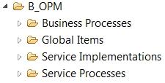
OPM in RSA consists of 4 top-level folders
Business Processes
  400+ business processes and activities arranged into specific areas of banking business interest
Global Items:
  Contains elements used throughout the model
Service Implementations
  Define how to implement complex services, by orchestrating calls to other automated tasks and services
  arranged into specific areas of business interest and aligned with similar APM Service Candidate hierarchy
Service Processes
  500+ service processes arranged into specific areas of business interest and aligned with similar BOM Capability View hierarchy
  Service processes contain Service Tasks linked to service operations defined in the SDM
BPS for Standard Tooling

Slide 12

OPM in RSA consists of 4 top-level folders
Business Processes
  Business processes and activities arranged into specific areas of banking business interest
Global Items:
  Contains elements used throughout the model
Service Implementations
  Define how to implement complex services, by orchestrating calls to other automated tasks and services
  Arranged into specific areas of business interest and aligned with similar APM Service Candidate hierarchy
Service Processes
  Service processes arranged into specific areas of business interest and aligned with similar BOM Capability View hierarchy
  Service processes contain Service Tasks linked to service operations defined in the SDM
IPS for Standard Tooling

Slide 13
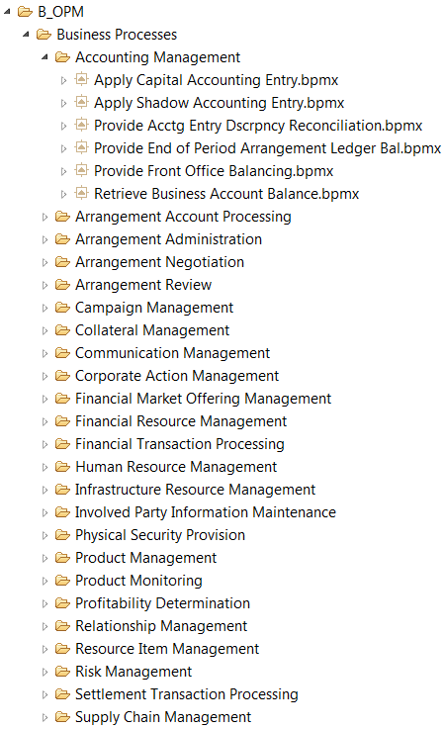
Business Processes package is composed of business functional areas with which Global Processes and Tasks are aligned
IFW Orchestration Process Model
Business Function Package
Global Process
Global Process
Business Function Package
Global Process
Global Process
BPS for Standard Tooling
Notes:
Value Chains add a business Context into the processes.

Slide 14
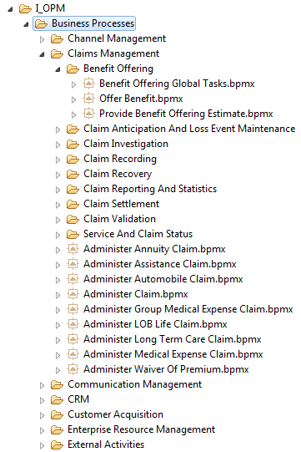
Business Processes Package is comprised of business functional decomposition with which Global Processes and Global Tasks are aligned
IPS OPM
Business Processes
Business Function Package
Business Function
Sub Package
(Manual) Global Task
Global Process
Top Level Global Process
External Activities
(External) Global Task
IPS for Standard Tooling
Notes:
Value Chains add a business Context into the processes.

Slide 15
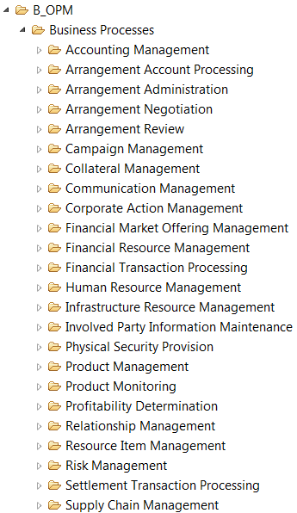
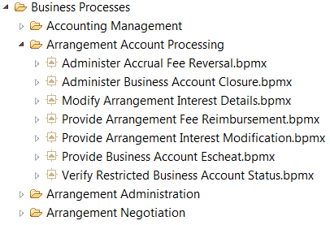
Business Processes Package contains hierarchy of business processes
400 Processes divided into 24 sub-packages comprising specific areas of business interest
Each sub-package contains a set of BPMN2.0 process models.
The sub-packages are organizational concepts. They:
  are supported in some tooling environments (e.g. RSA) and not in others (e.g. BPM)
BPS for Standard Tooling

Slide 16
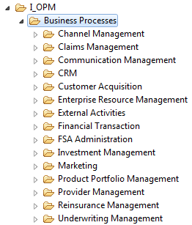
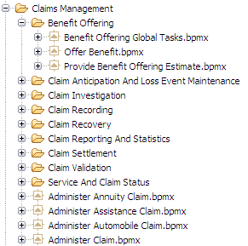
Business Processes Package contains hierarchy of business process
Processes divided into sub-packages comprising the insurance business functional decomposition.
Each sub-package contains further sub-packages which in turn consist of a BPMN2.0 process model and, optionally, further sub-packages
The sub-packages are organizational concepts. They:
  are supported in some tooling environments (e.g. RSA) and not in others (e.g. BPM)
  may be nested into sub decompositions.
IPS for Standard Tooling

Slide 17
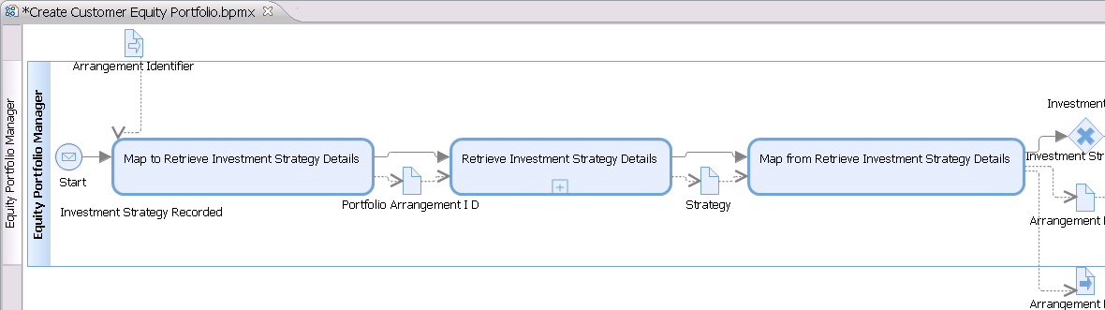
Process Diagrams are in BPMN2.0 format – Business Process example
Call Activity - Links to a service sub-process
Data Input
  Input to process
  References Item Definition
Start Event
  with Message Trigger
Exclusive Gateway
Call Activity – Links to a Global Task
Data Object
  References Item Definition
Lane
  linked to Resource
Data Output
  Output from process
  References Item Definition
BPS for Standard Tooling

Slide 18
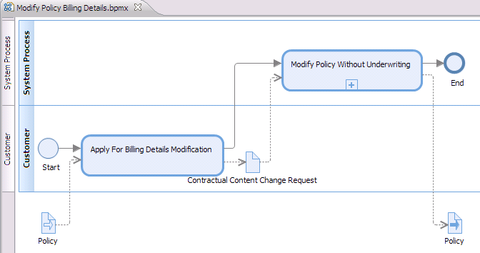
Process Diagrams are in BPMN2.0 format
Lane
  links to Resource
Call Activity - Links to a service sub-process
End Event
End Event
Call Activity - Links to a Global Task
Start Event
Data Input
  Input to process
  References Item Definition
Data Object
  References Item Definition
Data Output
  Output from process
  References Item Definition
IPS for Standard Tooling

Slide 19
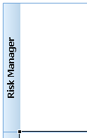



Subset of BPMN2.0 Model Notation used in OPM
Image
BPMN
Description
Examples
A Lane is a sub-partition within a Process.
Lanes are used to organize and categorize Activities.
Risk Manager
Asset Manager
Lane
Start Event
Start Event(s) indicate where a particular Process will start.
There must be only one Start Event per Sub-process, and at least one Start Event per top-level process.
Start Events may have Triggers which indicate the reason for the Start Event being called.
Trigger Types supported:
Message :
Timer:
Global Task
A Task is an atomic Activity within a Process flow, used used when the work in the Process cannot be broken down to a finer level of detail. All Tasks in the OPM are Global. i.e. They are accessible to all Processes.
Allocate Funds
(Global)
Process
A Process describes a sequence or flow of Activities in an organization with the objective of carrying out work.
All Sub-Processes in the OPM are Global i.e. they are accessible to all Processes.
Provide loan disbursement
Call Activity
A Call Activity identifies a point in the Process where a global Process or a Global Task is used. The Call Activity acts as a ‘wrapper’ for the invocation of a Global Process or Global Task within the flow diagram.

Slide 20





Subset of BPMN2.0 Model Notation used in OPM (cont)
Image | BPMN | Description | Examples
 |  | A diverging Exclusive Gateway (Decision) is used to create alternative paths within a Process flow
 |  | A converging Exclusive Gateway is used to merge alternative flow paths in the process.
 |  | A Diverging Parallel Gateway is used to create parallel flow paths in the process flow .
 |  | A Converging Parallel Gateway is used to synchronize (combine) parallel flow paths in the process flow.
 |  | An End Event indicates where a Process will end. There can be multiple End Events in a Process, one for each flow path. End Events may have triggers, called Results, which indicate the reason for the End Event being called.
 | Sequence Flow | The Sequence Flow connectors indicate the flow path along which activities occur.
Exclusive Gateway (Diverging)
Exclusive Gateway (Converging)
Parallel Gateway (Diverging)
Parallel Gateway (Converging)
End Event
Result Types
supported:
Message :

Slide 21



Subset of BPMN2.0 Model Notation used in OPM (cont)
Image | BPMN | Description | Examples
 | Data Object | Data Objects provide information about what Activities require to be performed and/or what they produce. Data Objects can represent a singular object or a collection of objects
 | Data Input | A Data Object required as input to a process.
 | Data Output | A Data Object produced as output from a process.
 | Data Input Association | A connector used to show data object input to an Activity or Process.
 | Data Output Association | A connector used to show data object input to an Activity or Process.

Slide 22
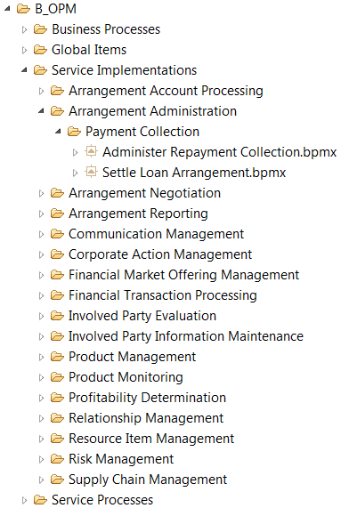
Service Implementations package is composed of design-level processes aligned with the APM Service Candidate Processes
IFW Orchestration Process Model
Business Function Package
Global Process
Global Process
Business Function Package
Global Process
Global Process
BPS for Standard Tooling
Notes:
Value Chains add a business Context into the processes.

Slide 23
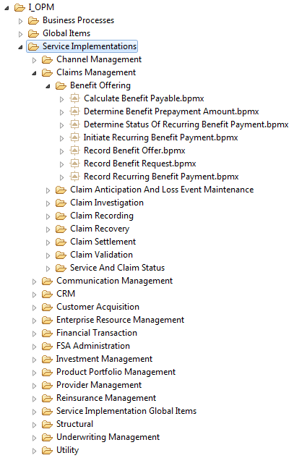
Service Implementations package is composed of design-level processes aligned with the APM Service Candidate Processes
IPS OPM Service
Implementation
Business Function Package
Global Process
Global Process
Business Function Package
Global Process
Global Process
IPS for Standard Tooling
Notes:
Value Chains add a business Context into the processes.

Slide 24
Service Implementations Package contains hierarchy of service implementation processes
140 Processes divided into 17 sub-packages comprising specific areas of business interest, and aligned with the APM Service Candidates hierarchy
Each sub-package contains further sub-packages which in turn consist of BPMN2.0 process models
The sub-packages are organizational concepts. They:
  are supported in some tooling environments (e.g. RSA) and not in others (e.g. BPM)
Service Implementations define how complex services are implemented, by orchestrating calls to other automated tasks and services.
If a user wants to deploy complex services they may choose to create Service Implementations in the OPM, which can be exported to BPMN 2.0 format and imported into a process execution environment and used to implement services
BPS for Standard Tooling

Slide 25
Service Implementations Package contains hierarchy of service implementation processes
Processes divided into 16 sub-packages comprising specific areas of business interest, and aligned with the APM Service Candidates hierarchy
Each sub-package contains further sub-packages which in turn consist of BPMN2.0 process models
The sub-packages are organizational concepts. They:
  are supported in some tooling environments (e.g. RSA) and not in others (e.g. BPM)
Service Implementations define how complex services are implemented, by orchestrating calls to other automated tasks and services.
If a user wants to deploy complex services they may choose to create Service Implementations in the OPM, which can be exported to BPMN 2.0 format and imported into a process execution environment and used to implement services
IPS for Standard Tooling

Slide 26
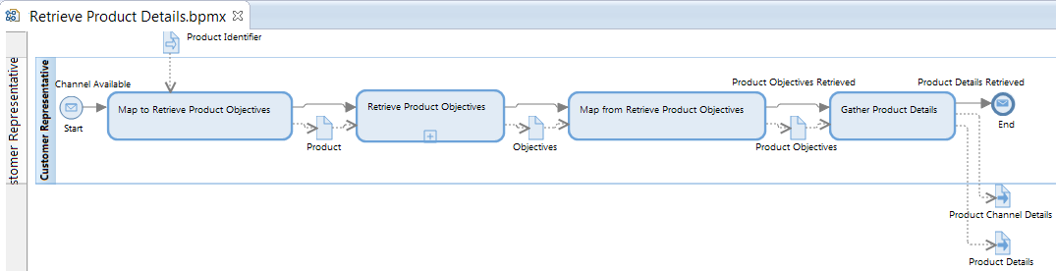
Service Implementation Diagrams are in BPMN2.0 format
Data Input
  Input to process
  References Item Definition
Call Activity - Links to a Service Process
Start Event
  with Message Trigger
Call Activity – Links to a Global Task
Data Object
  References Item Definition
Lane
  linked to Resource
Data Output
  Output from process
  References Item Definition
BPS for Standard Tooling

Slide 27
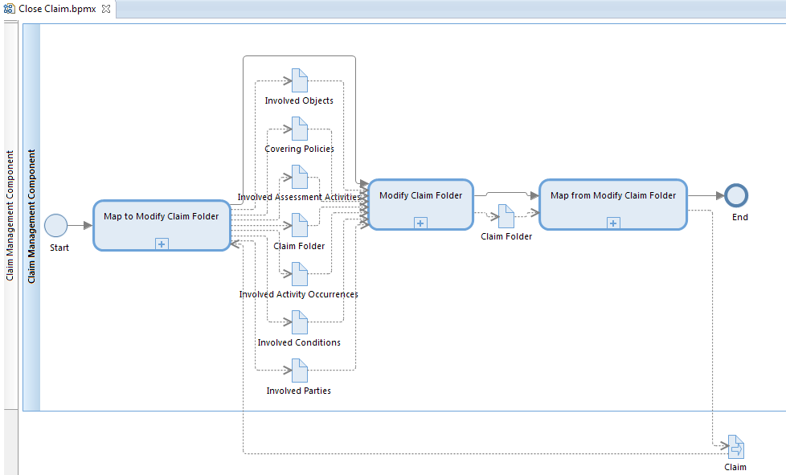
Service Implementation Diagrams are in BPMN2.0 format
Call Activity - Links to a Service Process
End Event
Start Event
Data Object
  References Item Definition
Data Input / Output
  Input / Output from process
  References Item Definition
Lane
  linked to Resource
IPS for Standard Tooling

Slide 28
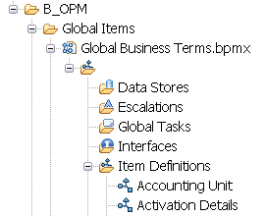
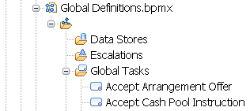


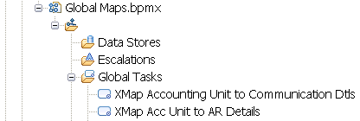
Global Items Package contains elements used throughout the model
Global Business Terms:
  Data Item Definitions defined for global use throughout the OPM.
  Item Definitions are mapped to from IDM Transfer Objects
Global Definitions
  Global Tasks, which are smallest unit of business activity, and defined for global use throughout the OPM.
  Item Definitions mapped to from IDM Transfer Objects.
  Additional to the Item Definitions defined in “Global Business Terms“ in the APM and OPM. These Item Definitions refer to Service Process data inputs and outputs
  Resources: human or system performers of process tasks
  Used as Lane names in process diagrams
Global Maps
  List of Global Tasks which designate mapping activities between one data item and another
BPS for Standard Tooling

Slide 29
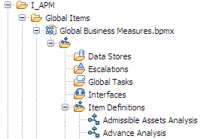
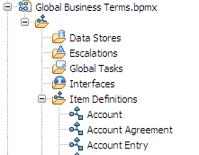


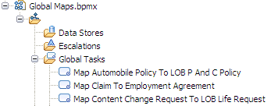
Global Items Package Contains elements used throughout the model
Global Business Measures:
  Data Item Definitions defined for global use throughout the APM and IUC, particularly used for Informational Activities.
Global Business Terms:
  Data Item Definitions defined for global use throughout the APM and IUC.
  Item Definitions are mapped to from BOM Classes
Global Definitions
  Resources: human or system performers of process tasks
  Used as Lane names in process diagrams
Global Maps
  List of Global Tasks which designate mapping activities between one data item and another
IPS for Standard Tooling

Slide 30
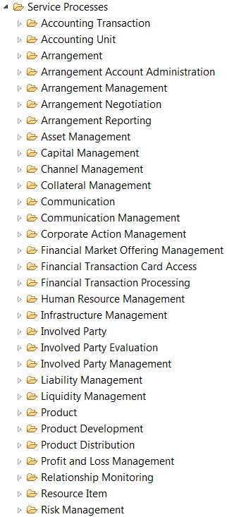
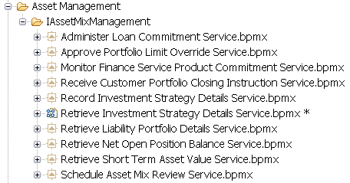
Service Processes Package contains hierarchy of service processes
600+ Service Processes divided into 31 sub-packages comprising specific areas of business interest, and aligned with the BOM Capability hierarchy
Each sub-package contains further sub-packages which in turn consist of BPMN2.0 process models
The sub-packages are organizational concepts. They:
  are supported in some tooling environments (e.g. RSA) and not in others (e.g. BPM)
  may be nested into sub areas
BPS for Standard Tooling

Slide 31
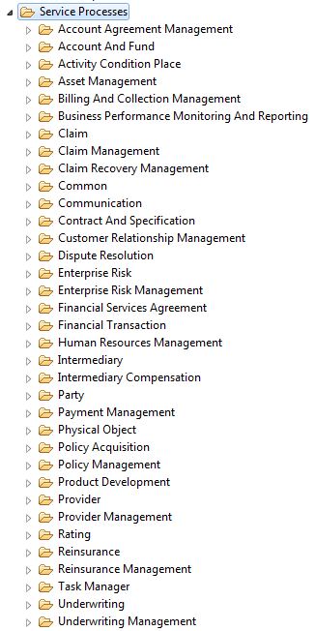
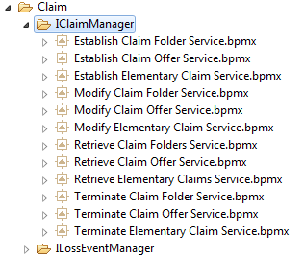
Service Processes Package contains hierarchy of service processes
Service Processes divided into 35 sub-packages comprising specific areas of business interest, and aligned with the BOM Capability hierarchy
Each sub-package contains further sub-packages which in turn consist of BPMN2.0 process models
The sub-packages are organizational concepts. They:
  are supported in some tooling environments (e.g. RSA) and not in others (e.g. BPM)
  may be nested into sub areas
IPS for Standard Tooling

Slide 32
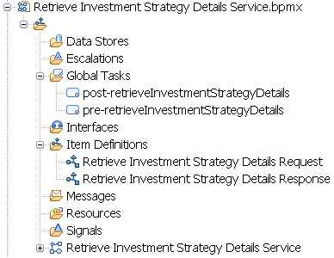
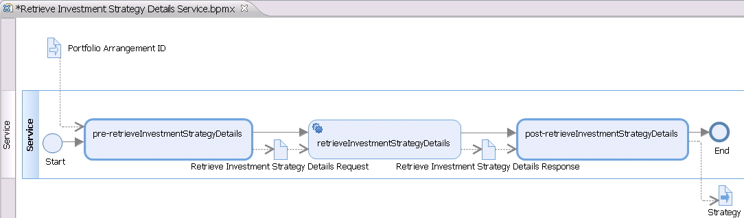
Service Processes contains specific local definitions
Global Tasks, which are relevant only to this service subprocess.
Item Definitions
  Additional to the Item Definitions defined in the “Global Items” package
  mapped to from IDM Transfer Objects.
BPS for Standard Tooling

Slide 33
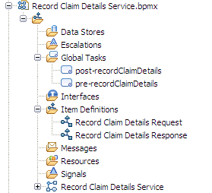
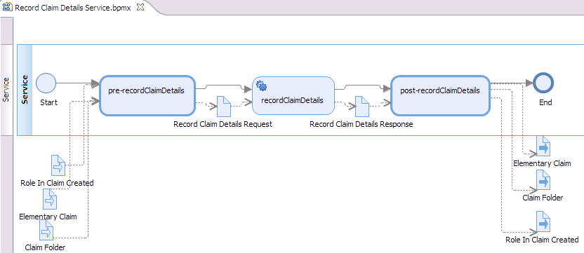
Service Processes contains specific local definitions
Global Tasks, which are relevant only to this service subprocess.
Item Definitions
  Additional to the Item Definitions defined in the “Global Items” package
  mapped to from IDM Transfer Objects.
IPS for Standard Tooling

Slide 34
Service Process Diagrams are also in BPMN2.0 format
Lane
  linked to Resource
Service Task
  Service Operation (in SDM)
Data Input
  input to process
End Event
  without Result
Call Activity
  To a Global Task
Data Object
Data Output
  output from process
Start Event
  without Trigger
BPS for Standard Tooling

Slide 35
Service Process Diagrams are in BPMN2.0 format
Lane
  linked to Resource
Service Task
  Service Operation (in SDM)
Start Event
  without Trigger
End Event
  without Result
Data Object
Data Input
  input to process
Call Activity
  To a Global Task
Data Output
  output from process
IPS for Standard Tooling

Slide 36
Agenda
Positioning of OPM in Standard Tooling model set
Process model structure
  Global Items
  Process hierarchy
  Process diagrams
  Services
Summary

Slide 37

Summary
Process Model represents a detailed expression of the end to end processing requirements that support the business.
OPM - Provides template process model solutions that fast tracks the process design phase
OPM process diagrams are in BPMN2.0 format
Accelerate solution development, thereby, reducing development time and cost
Eliminate redundancy in process variation by maximizing the level of activity and trigger reuse
Provide an enforcement model for naming standards across all projects within the Bank. This ensures that the level of re-use is being maximized.
Process Models exist in two levels of details – as Analysis and Design Model. OPM is a Design level model.
‘Out of the Box’ OPM is expected to be adapted/customized to support the process design phase of the project

